Slide 1
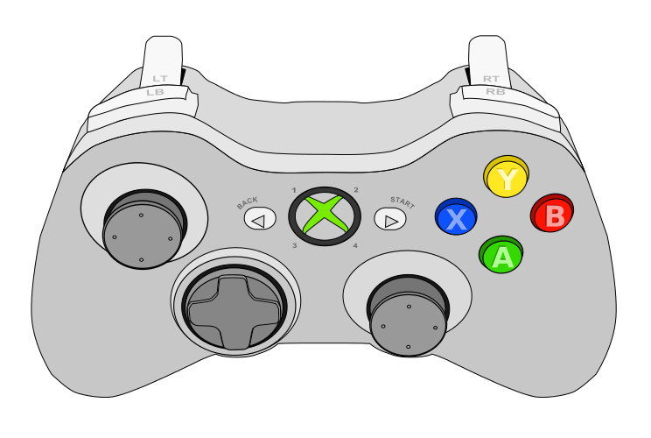
Algae Ground
Intake Sequence
Coral Intake Sequence
STOP All Motors
Coral L1 PREP*
Coral Reverse
Intake Sequence
Coral L4 PREP*
* Set Coral Mode
** Set Algae Mode
*** Set Neutral Mode
Coral L3 PREP*
Coral L2 PREP*
Processor PREP**
Net PREP**
Algae Intake
Reef Upper
Algae Intake
Reef Lower
Elevator MANUAL
(While Held)
HOME Sequence***

Slide 2
Wrist Nudge DOWN
Wrist Nudge UP
Reset Pose
Clear Sticky Faults
Elevator Nudge UP
Climb PREP
Elevator Nudge DOWN
Elevator Manual UP
Climb Manual UP
Elevator Manual DOWN
Climb Manual DOWN
Wrist Manual UP
Coral Rollers OUT
Wrist Manual DOWN
Coral Rollers IN

Slide 3
DRIVE JOYSTICK
ROTATE JOYSTICK
Release Game Piece (DEPENDING ON MODE)
Lock to Reef
and Fine Control (HOLD)
Climb Sequence
(IF ACTIVATED)
Lock to Loading Station
and Fine Control (HOLD)

Slide 4
Disabled
TBD
Elevator At Target Pos
Intake Running
Algae Mode
Coral Mode
Climb

Slide 5
Algae Mode Processor
Algae Mode Lower Reef
Algae Mode Upper Reef
Algae Mode Net
Coral Mode L1
Coral Mode L2
Coral Mode L3
Coral Mode L4

